Slide 1
Rating and Pricing
Ashwin Jain

Slide 2
What is Rating ?
Rating is the process of applying rates and charges to the amount of Services consumed(Usage) by the Subscriber to calculate the amount payable by him/her.
It is the core of a Billing System.

Slide 3
Difference between Rating and Billing
Rating means that it simply applies the prices to individual usage records, rating each event independently.
After Rating, these rated records are consolidated and aggregated by Billing to calculate the final bill amount for a Subscriber’s account.

Slide 4
Rating vs Billing
Rating | Billing
Rating calculates how much a customer should be charged for usage. | Billing does not involve measurement of events
Rating stores the charges in Bill items. Updates the customer account balance | Billing collects existing rated records and generates a bill
 | The service or the action that generate the event is irrelevant to creating the bill

Slide 5
Rating Process
Rating Engine picks up usage records from the mediation device either in batch or Online.
Incoming records are validated and then matched with other records to describe the services rendered.This creates transactions.
Transactions are evaluated against information about the customer’s rate plan to determine what billable events occurred.

Slide 6
Rating Process contd….
Billable events are then rated to set the price for the billable event.
Rating also includes discounts, unit credit points and/or surcharges that are applied at a single transaction level.
In case of internationalized installation, Rating should also take care of Currency conversion rates.
These rated events are formatted in the output format(s) employed by the systems that receive the rating output , normally , Billing Engine.

Slide 7
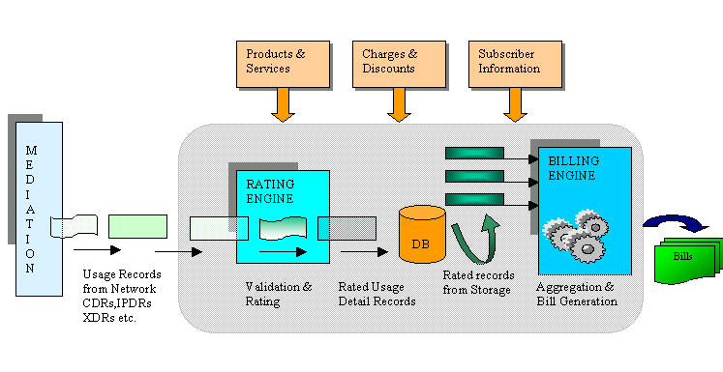
Rating Engine in a Billing System

Slide 8
Inputs to Rating Engine
Usage Records : CDRs/IPDRs/XDRs etc fed by the Mediation device.
CDR – Call Detail Records
IPDR – IP Detail Records
XDR – eXtensible Detail Records
Subscriber Information : Subscriber contract details .
Services & Products Information : This module provides services and products information and the units to measure these services.
Example : Volume,Duration,QOS,Content

Slide 9
Types of Rating Engines
Table Driven Rating Engine
Rule-based Rating Engine

Slide 10
Table Driven Rating Engine
Uses predefined tables of data that expresses the service and rating plan desired.
Usually processes more transactions per hour than a rule based RE.
Problem :When a new kind of rating model is required , data table definitions need to be modified and even the program code need to be changed.

Slide 11
Rule Based Rating Engine
Uses program like rules that guide the rating process.
Rule based raters must interpret the rules as they are processed.
New rating models can be easily implemented.

Slide 12
Architecture of a Typical Rating Model
NE
Mediation
Collection Agent
Rating Server
Formatter
Pricing Engine
Rejected Records
Database

Slide 13
Complexities of Rating
Product Bundling and Discounting :
Product Bundling means grouping together of various products and selling them as a single saleable object.
Example : A bundle having Voice , Voice mail and caller line identification services.
Rating becomes even more complicated with cross product Discounting.

Slide 14
Complexities of Rating contd…
Rounding : Process of taking actual measures and converting them to a specified degree of accuracy or rounding factor
Example : For a call duration various rounding increments like 1sec, 6sec, 30sec etc can be defined.

Slide 15
Complexities of Rating contd…
Prorating : This is the process of calculating charge for partial usage.
If a subscriber chose to terminate the service in middle of the billing cycle , or there is a change in the Rating plans or change of Billing date itself , Prorating needs to be done.

Slide 16
Complexities of Rating contd…
Roaming : Roaming is the process of getting connected to one’s home network while on move.The service providers have to get themselves registered to any of the remote access service providers .
Usage records generated would be rated as per the agreement between the roaming partners.

Slide 17
Complexities of Rating contd…
SLA Compliance : SLA compliance of a billing product would imply service providers offering the service for which SLA could not be kept at a discounted or lower rate than what it was originally priced for.
This requires a powerful Rating engine to discount the difference between the user’s service expectations and what was actually delivered to him.

Slide 18
Pricing Module

Slide 19
Pricing Module
This is the module where various prices and rate structures are defined to charge the subscriber.
Also various promotional schemes in terms of discounts, credit points , loyalty points can also be defined.

Slide 20
Types of Charges
Recurring Charges : Also referred to as Subscription charge.This charge is associated with a Service and the subscriber is bound to pay it irrespective of any Service usage.
Example : Monthly Subscription Charge

Slide 21
Types of Charges contd…
Non Recurring Charges : NRCs are the one time charges like Account activation charge or charge for a Product , Cancellation charge , Late Payment charge, Installation fee etc.
Usage Charges : Charge associated with the extent of consumption of a particular service .
Example : Call duration of 7 mins, Download of 552 MBs etc.

Slide 22
Types of Rate Structures
Flat Rate : Flat Rating provides a charge that is not a factor of the number of units within a charge transaction.
It assumes a flat rate throughout the day regardless of the time of the day the call was made or the duration of the call .
Example : a Flat rate of charge @ US$ 10 for a call however long and during any part of the day .

Slide 23
Types of Rate Structures contd…
Tiered Rate - Tier rating provides a unit rate for each band for which the charge applies.
This breaks up the day into different time periods and defines different rates for different usage slabs within each time periods .
Example : During off-peak hours a rate of US $ 1 for the first 10 minutes and US $ 2 for the next 20 minutes and so on

Slide 24
Types of Rate Structures contd…
Threshold Rate : Threshold rating provides a single unit rate for the highest band for which the charge applies.
They are similar in definition to Unit Tier but differ in the way the charges are calculated . Here the calls are charged based on the slab where the threshold of usage falls .

Slide 25
Types of Rate Structures contd…
For example : If a Tier rate and Threshold rate are defined similarly for off-peak hours as : US $ 1 for the first 10 minutes and US $ 2 for the next 20 minutes , then for a call of duration 15 minutes Unit Tier will calculate US$ 1 for the first 10 minutes and US $ 2 for the next 5 minutes . Whereas Unit Threshold will calculate US$ 2 for the entire 15 minutes which is the rate at the slab where the usage threshold falls

Slide 26
Rate Plans
A Rate Plan is a collection of one or more rates that apply to the same event.
Rate plans are used to specify when a rate is valid and the order in which valid rates should be applied to an event.

Slide 27
Summarizing
There lies a lot of onus on Rating Module when it comes to overall profitability in a Service Provider’s business.
RE must process all the traditional transactions of a SP and it must also deal with all the other operational complications.
RE should provide ease of implementation and be flexible enough to support services which are unborn as yet.

Slide 28

Thank You

